Slide 1
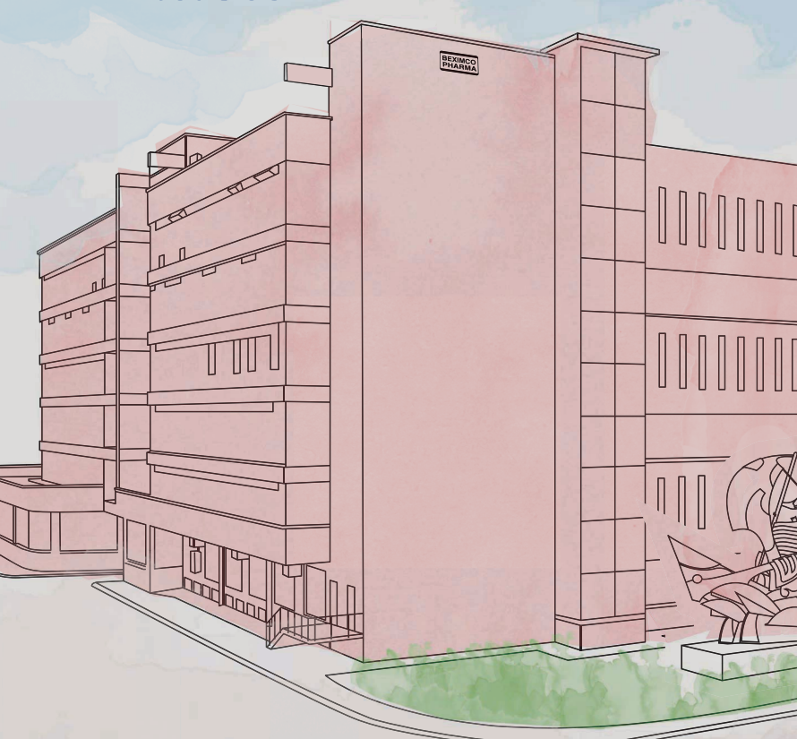
WELCOME TO MY PRESENTATION

Slide 2


annual Report 2022-23
Presented by:
Name: Md Awal Pramanik
Batch: 21
Department: Political Science
Date: 06-10-2024

Slide 3
Sequence of presentation
1
Brief Introduction to the Company
2
Beximco Pharma in International market
3
Contact us
Key products & services
6
Company’s Statistical
4
Our Achievement
7
5
Video Gallery

Slide 4
Brief Introduction to the company
One of the leading pharmaceutical manufacturing companies.
Founded in 1976
Started operations in 1980
Beximco Pharmaceuticals Limited (BPL) currently holds the third position in local sales.
Supplies more than 10% of country’s total medicine needs
Initially imported products from global MNCs
Started its exports operation in the early 90s with APIs
Employs more than 2,400 staff, including over 300 qualified professionals
Won the National Export Trophy (Gold) a record four times.

Slide 5
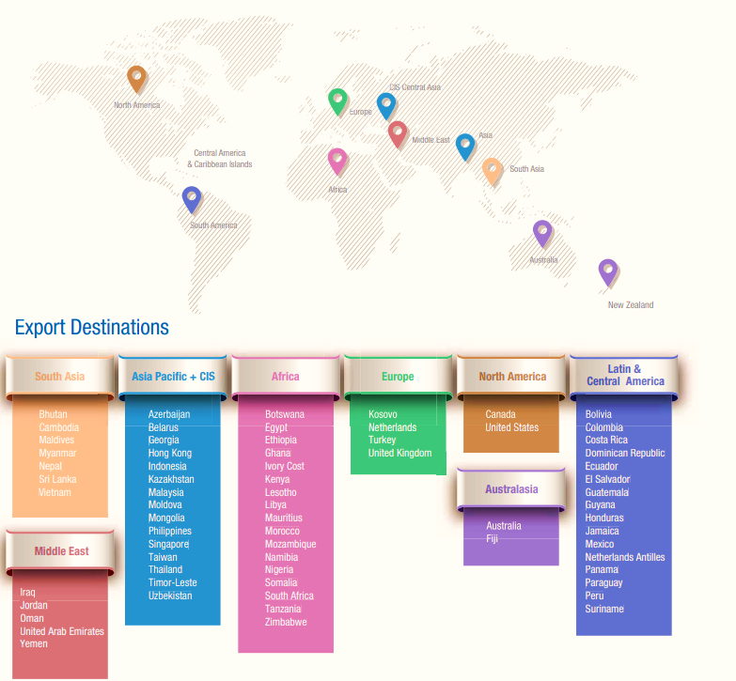
BPL in international market arena
Exploring export opportunity and reinforce its foot print on a global scale.
Started its international operations in 1992
Succesfully ventured into several new countries in 2010
Product registerd in Asia, Central and Latin America middle East in 2010
Products are highly trusted for their quality by physicians and consumers at home and abroad

Slide 6
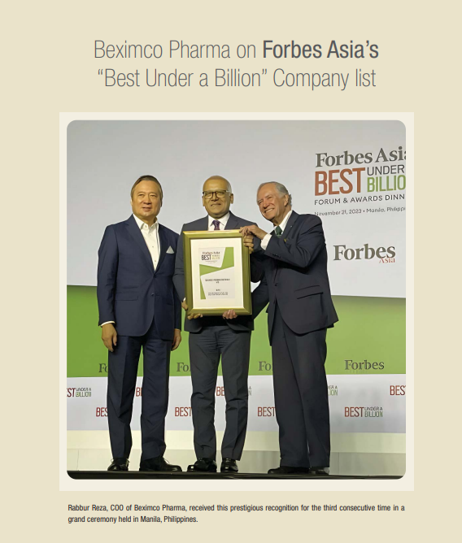
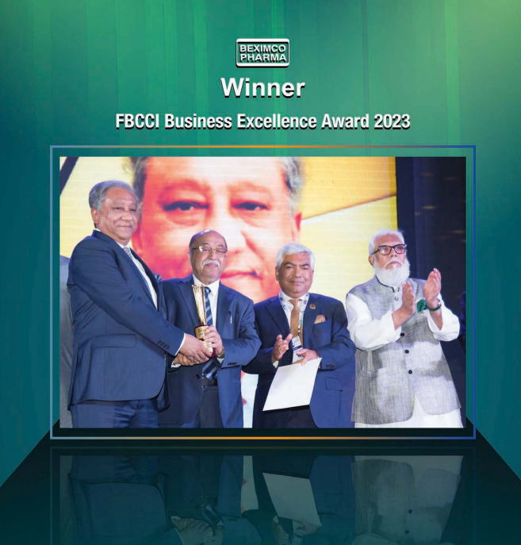
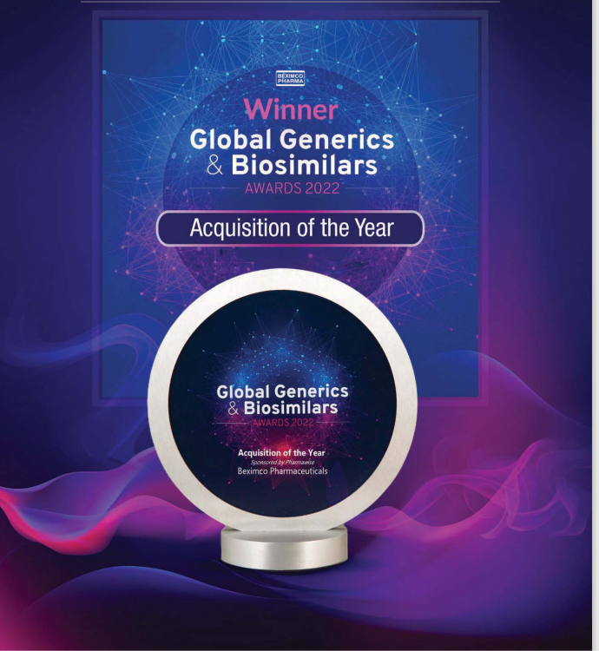
Our Achievement

Slide 7

Video Gallery

Slide 8
Key Products & service
Our Product Range
Beximco Pharma Ltd.
Allergic Disorders
Analgesis & Antipyretic
Anti-infective
Antiviral
Cardiovascular
Other Products
Oncology
Musculoskeletal
Intravenous Fluids
Harmone & Steroid
Gastrointestinal
Eye Care
Endocrine & Diabetics
Cough & Cold
Central Nervous System
Vitamin & Minerals Supplement
Respiratory
Skin Care
Urogenital

Slide 9
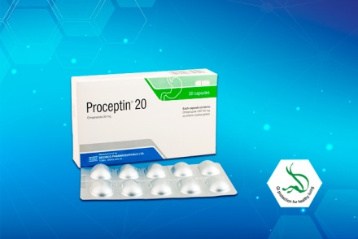
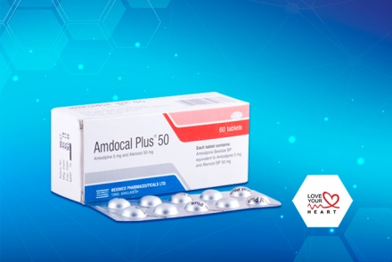
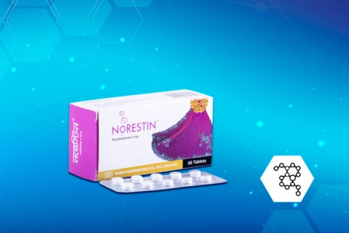
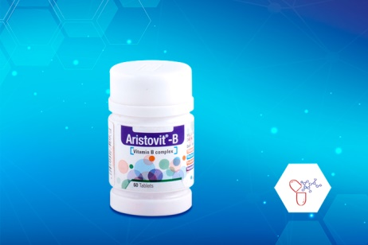
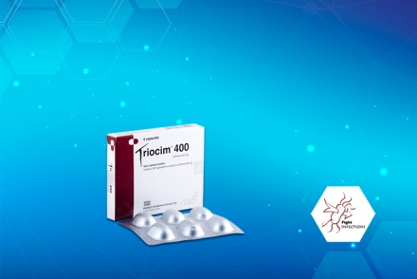
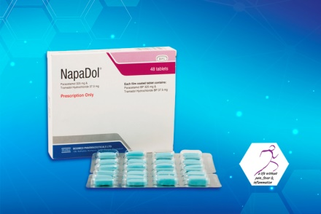
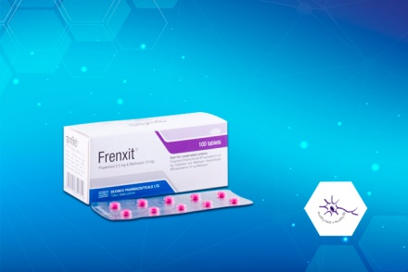
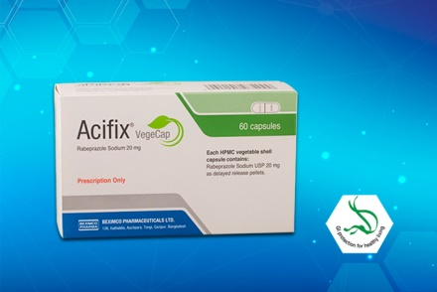
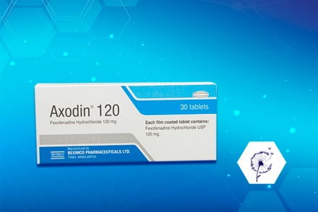
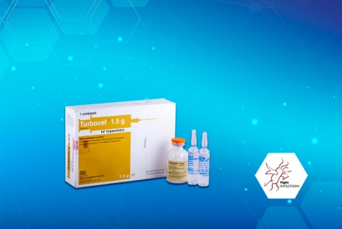
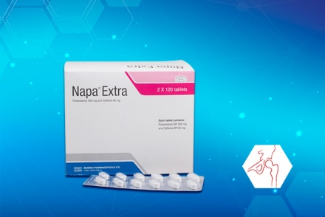
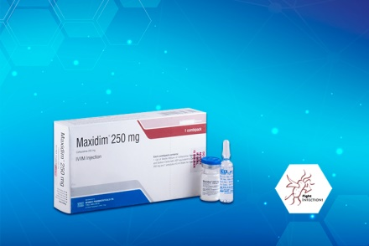
Key Products & service
Some Top Rated Products

Slide 10
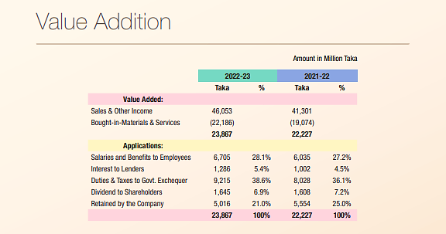
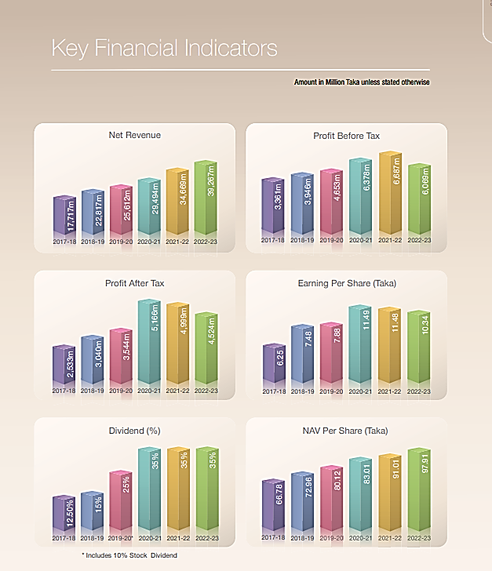
Company’s Statistical

Slide 11
Company’s statistical

Slide 12
Contact us
Operational Headquarters
Beximco Pharmaceuticals Ltd. 19 Dhanmondi R/A Road No. 7 Dhaka 1205 Bangladesh. +880-2-58611001-7 +880-2-58613888, +880-2-58614601 info@bpl.net
The Safety of our products and health & well-being of our patients continues to be our Highest Priority. For Medical Information, Product Complaint or Reporting of an Adverse Event involving Beximco Pharma Product please contact:
In the United States:
(877) 372-6093 (Monday – Friday 8am – 6pm Central Time GMT-6) (866) 578-4617 DrugSafety@propharmagroup.com
Outside the United States:
+8802-223364449 +8802-223364449 pharmacovigilance@bpl.net

Slide 13
THANK YOU
FOR WATCHING MY PRESENTATION

